Slide 1

Abacus introduction

Slide 2
Problem:
Cloud Foundry can (with the adequate resources) deploy 1000s of applications for 1000s of users.
Those users are grouped in Organizations and Spaces.
Each application and user can generate 100s of metrics per minute.
Day 2 Ops specify the need to monitor and measure the platform and resource usage.
Monitoring must happen in near-realtime.
Notes:
goal:
single platform for all devices
Increase quality and reduce the amount of stabilization
reduce planning.
PaaS is good fit for Project automatization
tests should be small.

Slide 3
Project Abacus:
Provides a solution to the metering problem for Cloud Foundry.
Measures:
Application usage - Creation, deletion, staging, etc.
Buildpack usage - What buildpack is used by who, with detailed information
Service usage - Number of instances of a service, data flow between applications and services
Metrics can be customized by user
Metrics collection and aggregation is near-realtime
Notes:
goal:
single platform for all devices
Increase quality and reduce the amount of stabilization
reduce planning.
PaaS is good fit for Project automatization
tests should be small.

Slide 4
Abacus Architecture

Slide 5
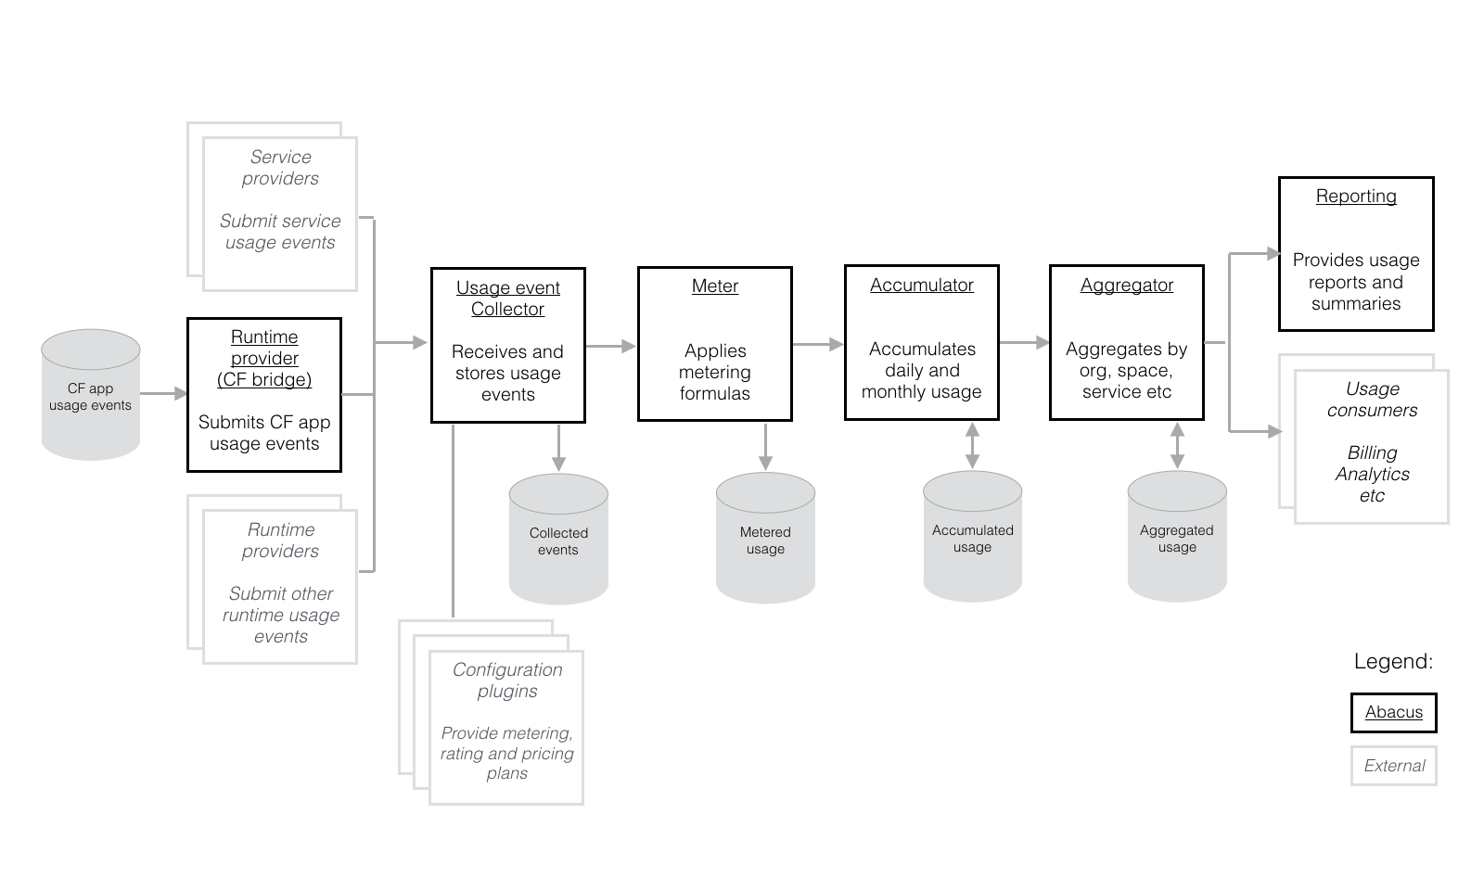
Notes:
goal:
single platform for all devices
Increase quality and reduce the amount of stabilization
reduce planning.
PaaS is good fit for Project automatization
tests should be small.

Slide 6
Stages: Resource provider
Entry stage of the pipeline
Service providers pushes usage information into the Abacus
Providers can be:
third-party services - service brokers that expose services to a CF environment
CF runtime itself - provides information about application lifecycle events
Notes:
goal:
single platform for all devices
Increase quality and reduce the amount of stabilization
reduce planning.
PaaS is good fit for Project automatization
tests should be small.

Slide 7
Stages: Usage event collector
Collects the usage information and stores it
Provides some initial preprocessing of the collected data
Notes:
goal:
single platform for all devices
Increase quality and reduce the amount of stabilization
reduce planning.
PaaS is good fit for Project automatization
tests should be small.

Slide 8
Stages: Metering
Applies metering formulas to collected data
Saves processed data to a database
Notes:
goal:
single platform for all devices
Increase quality and reduce the amount of stabilization
reduce planning.
PaaS is good fit for Project automatization
tests should be small.

Slide 9
Stages: Accumulator
Accumulates data over time (days, weeks, months, years) for consumption.
Notes:
goal:
single platform for all devices
Increase quality and reduce the amount of stabilization
reduce planning.
PaaS is good fit for Project automatization
tests should be small.

Slide 10
Stages: Aggregator
Aggregates logical identities such as organizations, spaces, applications, services, and users to the accumulated data.
Notes:
goal:
single platform for all devices
Increase quality and reduce the amount of stabilization
reduce planning.
PaaS is good fit for Project automatization
tests should be small.

Slide 11
Stages: Reporting
Format accumulated and aggregated data to produce a report. Consumers can customize how the reported data is presented.
Notes:
goal:
single platform for all devices
Increase quality and reduce the amount of stabilization
reduce planning.
PaaS is good fit for Project automatization
tests should be small.

Slide 12
Abacus Technology

Slide 13
Current Stack
node.js >= 5.10
npm >= 3.8
JSON for data representation
PouchDB for development stages
CouchDB or MongoDB for production storage

Slide 14
Abacus Usage

Slide 15
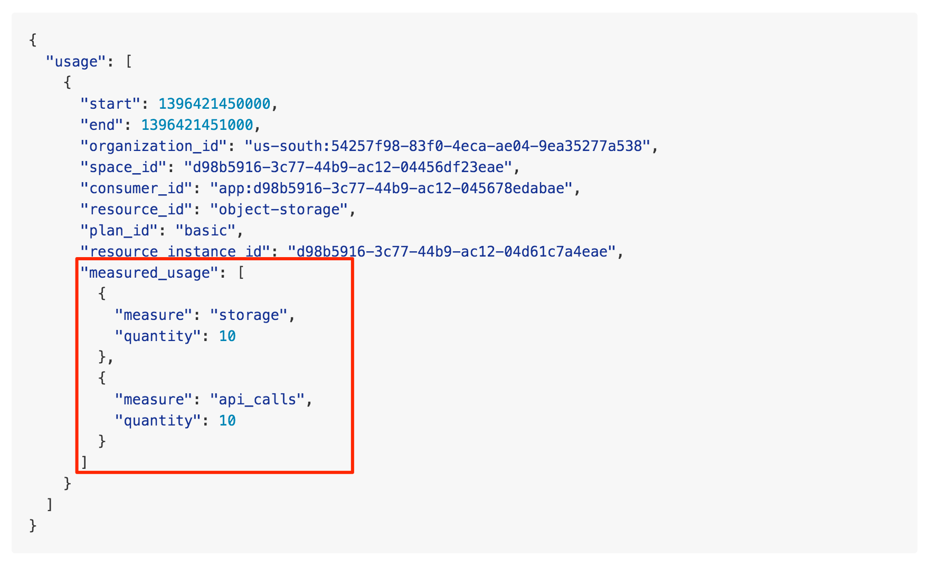
Submitted usage data

Slide 16
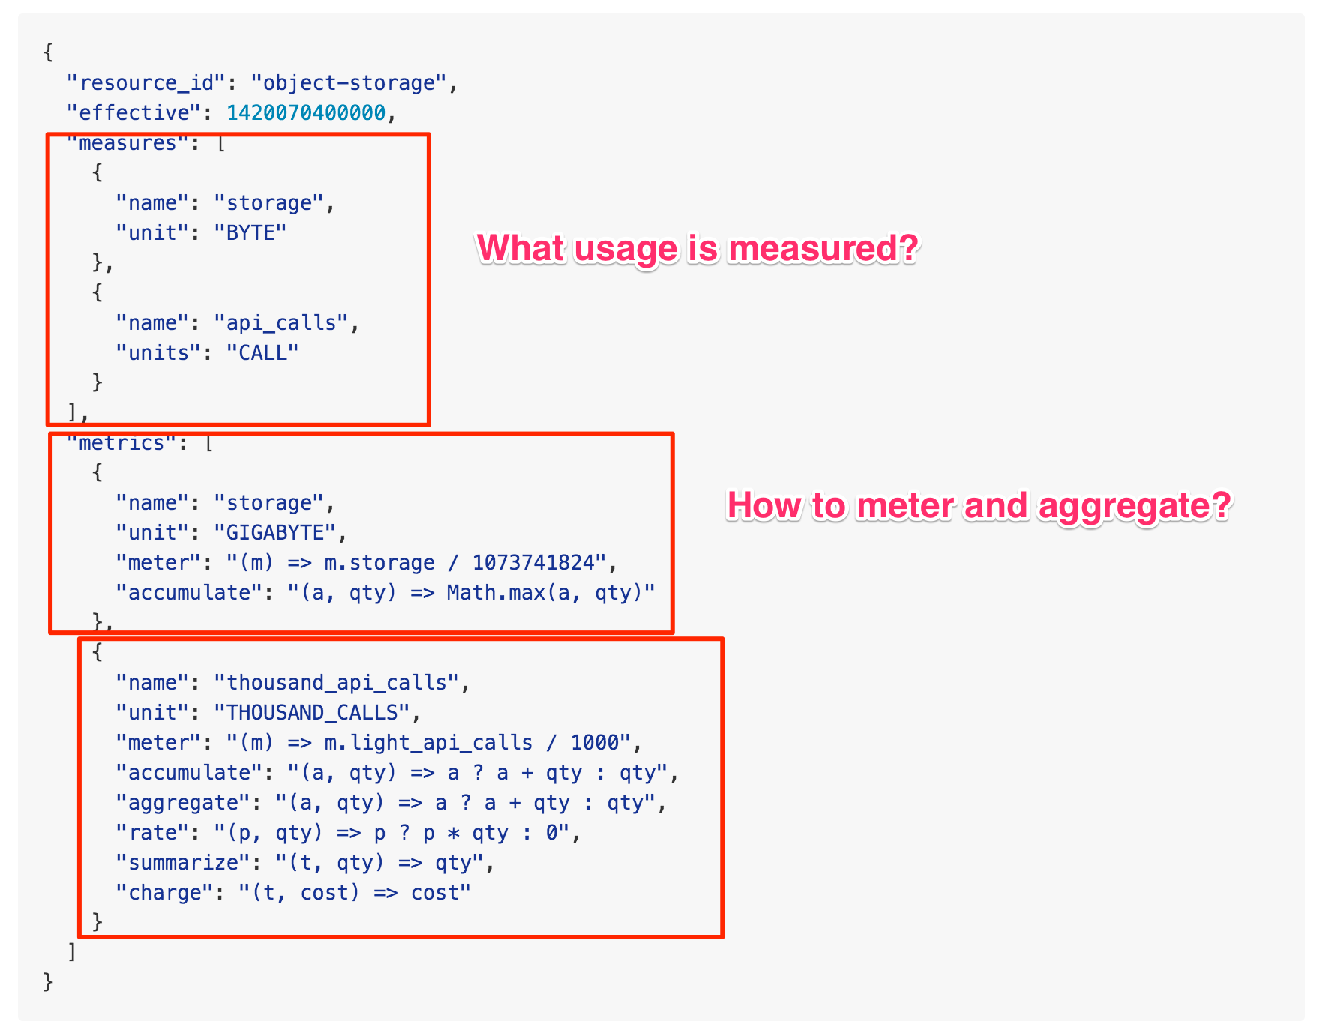
Metrics configuration

Slide 17
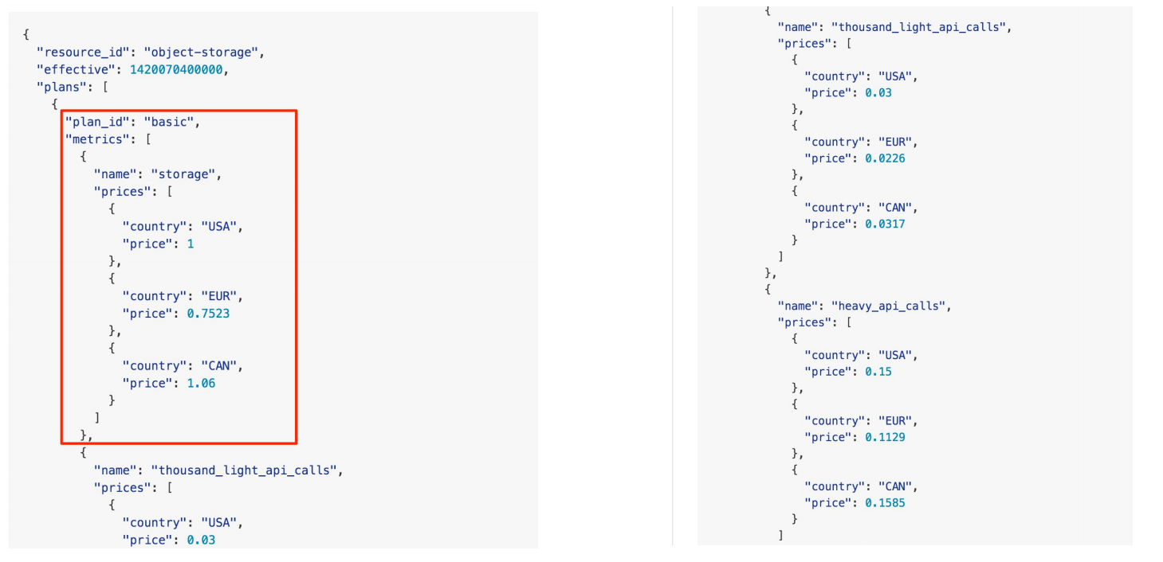
Resource pricing

Slide 18
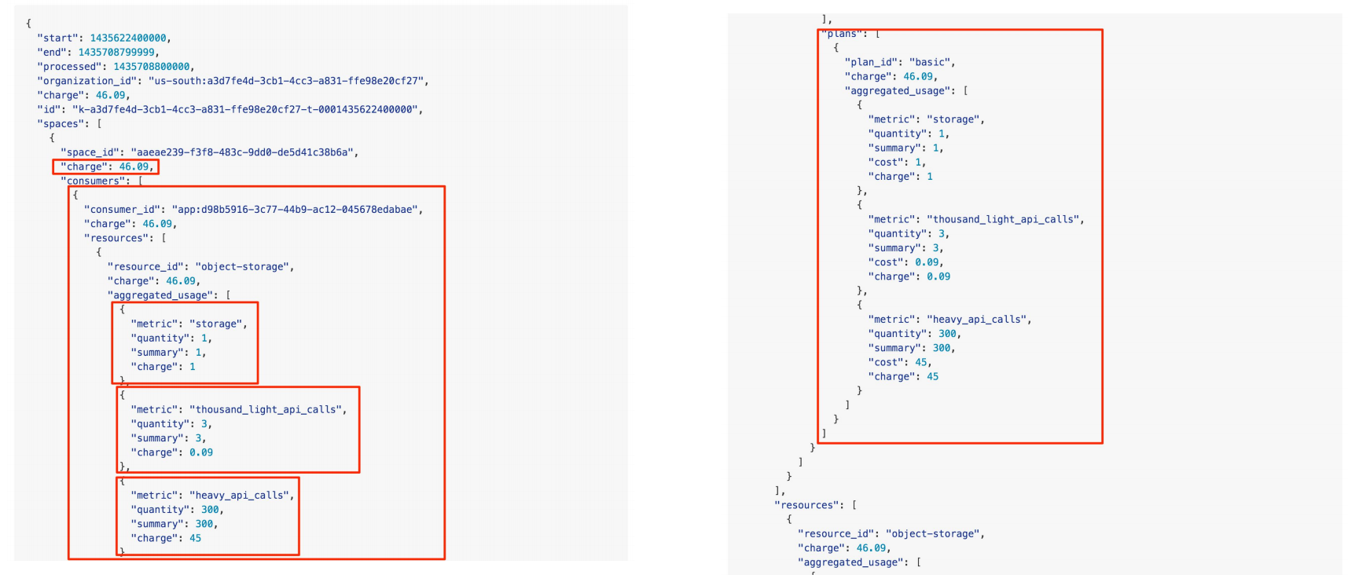
Sample report & resource usage

Slide 19
Abacus Deployment

Slide 20
$ git clone https://github.com/cloudfoundry-incubator/cf-abacus.git
$ cd cf-abacus # Point CF CLI to your local Cloud Foundry deployment and # create a CF security group for the Abacus apps $ bin/cfsetup # Run cf push on the Abacus apps to deploy them to Cloud Foundry $ npm run cfpush
# Run the demo script npm run demo -- \ --collector https://abacus-usage-collector.YOUR_CF_DOMAIN \ --reporting https://abacus-usage-reporting.YOUR_CF_DOMAIN

